Slide 1
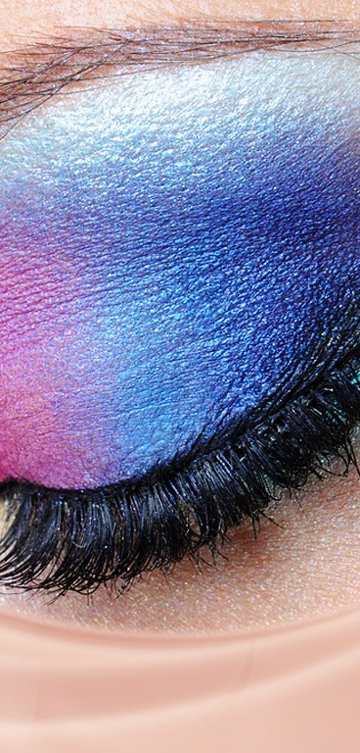
Web API and NLP
Classification of 2 subreddits:
Makeup & Travel
Mini Project 3
Kelvin Liew
27th April 2022

Slide 2

Approach
Problem Statement
1
Prepare the Data
2
Exploratory Data Analysis
3
Data Modelling
4
Present the Model
5

Slide 3
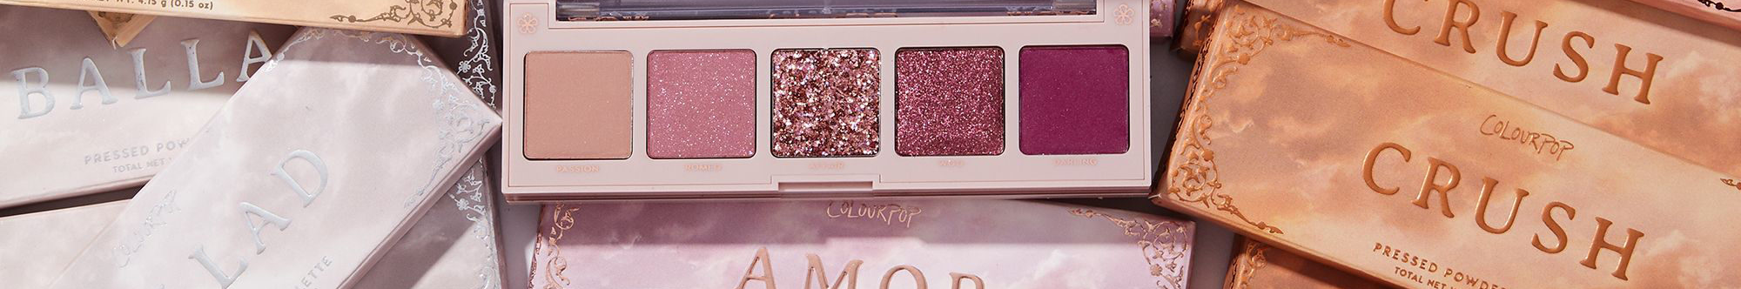
Problem Statement
“As more people get vaccinated, and travel restrictions are lifted, we expect the traveller to be hungry to travel again. Brands need to start considering how to reinvigorate travel content and apply key learnings from 2020 to ensure that content remains authentic and relatable,” said Tim Sovay, COO of CreatorIQ.
Solution
Use Pushshift API to collect 2 subreddits category: Makeup and Travel
Discover content and ideas for the next marketing activities
Use NLP techniques to train a Machine Learning model that will classify a text into the right subreddit

Slide 4


Prepare the Data
Data
Data Preparation Process
Subreddits scrapped
Selected Columns
Drop Null Value
Drop Duplicated
Check Metadata
Reddit is a network of communities where people can dive into their interests, hobbies and passions. There's a community for whatever you're interested in ...
Makeup: 1372 entries
Travel: 946 entries
Title
Subreddit
Selftext
Total 1500 entries
Makeup Selftext has 62 null values
Travel Selftext has 544 null values
There isn’t any duplicate rows
Makeup: 946 entries
Travel: 946 entries
Exploration Data Analysis (EDA)

Slide 5
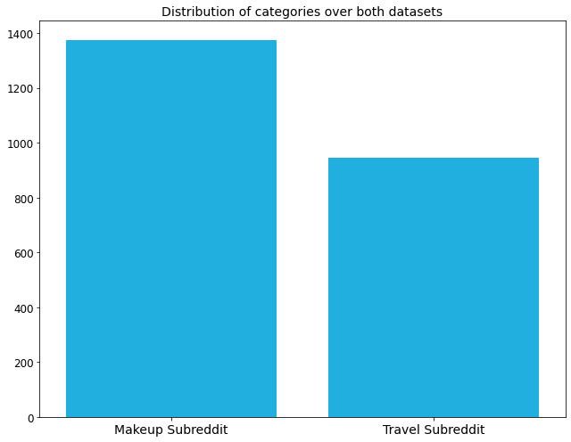

Exploratory Data Analysis (EDA)
Distribution of Data
As we can see from the plot, both categories are not very well balanced.

Slide 6
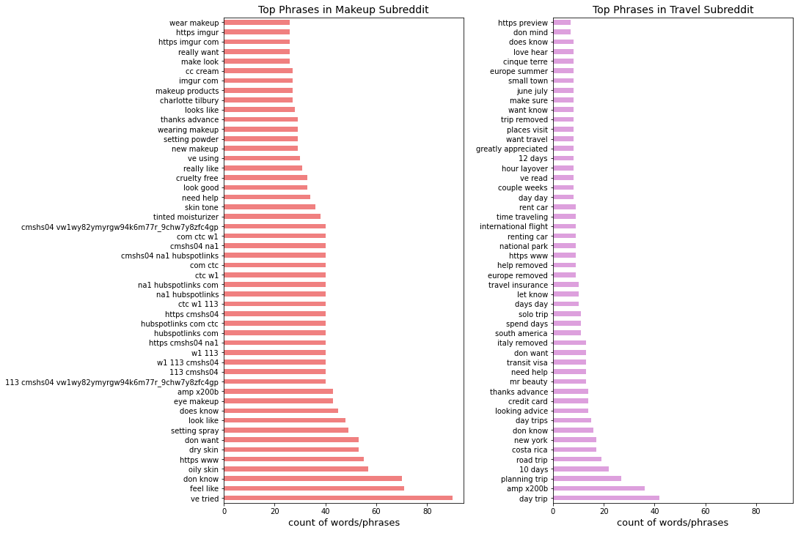

Analysis on Top Phrases
The histograms show the bigrams distribution over subreddit posts on both classes "Travel" and "Makeup" we can see that the bigrams distribution isn’t similar, which is normal due to the different context we’re scraping data from, also in terms of metrics the “Makeup” subreddit has more duplicated bigrams than “Travel“.

Slide 7

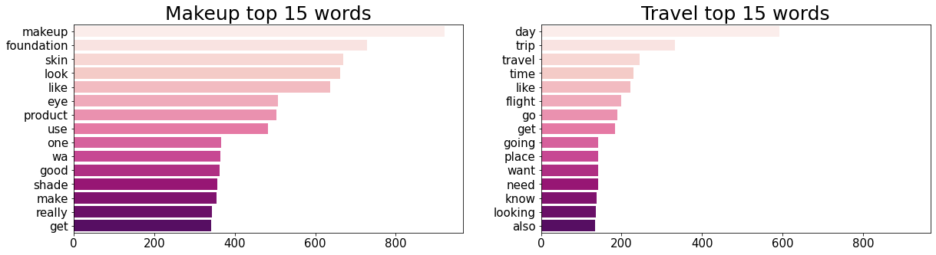
Analysis on Top 15 Words
Notes:
These histograms show us the most dominant unigrams/words by subreddit, as we can see the extracted words are very relevant to their corresponding subreddit; in addition, we can conclude that the "Makeup" community is very active and have more diverse words to use than the "Travel" one since the least used word is repeated around 150 times while on the other side on "Makeup" subreddit the last word is dominant with more than 250 appearances.

Slide 8
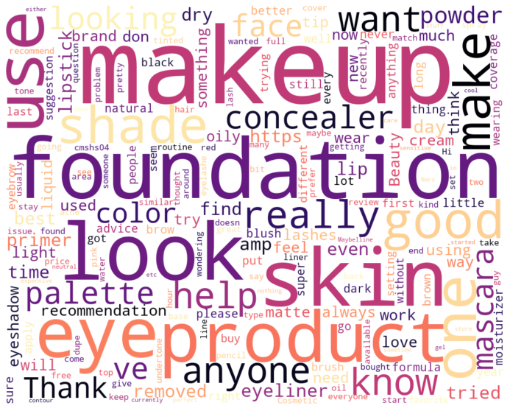
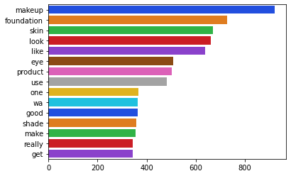
Top Words for Makeup
Notes:
The wordcloud figure is significant when it comes to exploring the word strength over a given corpus just visually by their font size without looking at the exact count, and from the figures here, we can see that the results are coherent; the wordcloud reflects the same results shown in the histogram.

Slide 9
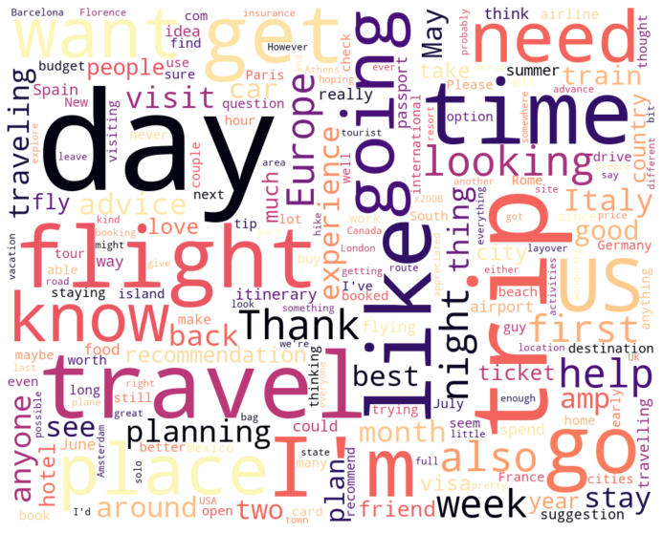
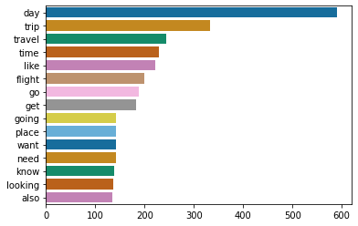
Top Words for Travel
Notes:
The wordcloud figure is significant when it comes to exploring the word strength over a given corpus just visually by their font size without looking at the exact count, and from the figures here, we can see that the results are coherent; the wordcloud reflects the same results shown in the histogram.

Slide 10
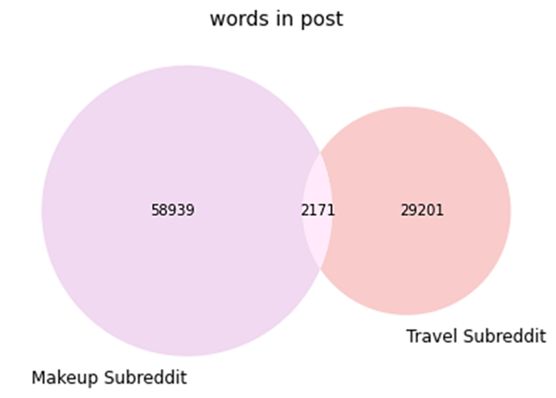
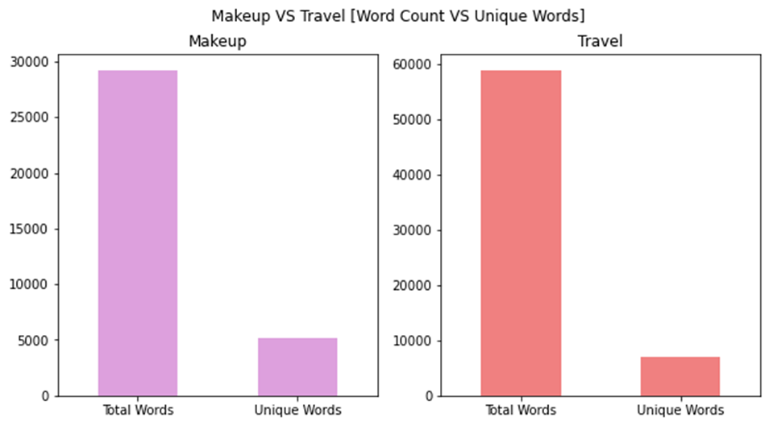
Common Words
Notes:
The figure on the left is a straightforward graph to see explore many words are shared between both subreddits; this might be useful to see if there is no collision between both vocabulary, and as we can see only 2,171 words in common which are low compared it to the vocabulary size. On the other hand, we can see that the gap in the count of unique words is fascinating between the two subreddits; the richness of the Travel vocabulary could interpret this upon the "Makeup" one.

Slide 11
Modeling Process
Combine selftext & title into one column
Drop unnecessary columns
Data Preprocessing
Convert labels into numerical values
Data splitting into train & test data set
ML classifiers training
Combine both dataframes in order to build one dataframe with texts data from both classes’ travel and makeup for modelling stages later.
We won't be using the other 2 columns i.e., full_text and tokens so we will drop them.
The features included in this preprocessing stage are :
Lowercase text
Remove whitespace
Remove numbers
Remove special characters
Remove emails
Remove stop words
Remove NAN
Remove weblinks
Expand contractions (if possible not necessary)
Tokenize
Converting makeup/travel into binary labels
0 stand for travel
1 stand for makeup
Value count to ensure there is no data imbalance. As we can see, the subreddits have slightly a gap of 430 rows. Hence we are going to rebalance the data by undersampling the most dominated subreddit.
Splitting the training dataset into random, equal-length example sets, i.e., 70% training set and 30% test set. For each set, a text classifier is trained with the remaining samples.
When a prediction was right (true positives and true negatives) and when it made a mistake (false positives, false negatives).
The modelling part of the project
Random Forest Classifier
Naïve Bayes Classifier
Notes:
Makeup and Travel Subreddit are combined into 1 dataframe:
Function called preprocess to do the following:
* lowercase text
* remove whitespace
* remove numbers
* remove special characters
* remove emails
* remove stop words
* remove additional stopwords such as: Makeup and Travel
* remove weblinks
* tokenize
select columns: subreddit and clean_message to be put to modelling
convert Travel: 0, Makeup 1 as their binary labels

Slide 12
Types of Models
 | Random Forest | Naive Bayes
Pipeline | CountVectorizer, RandomForestClassifier (random_state=42) | ("vec", None), ("model", MultinomialNB())
Pipe Parameters | 'cvec__max_features': [900, 1_000], 'cvec__stop_words': ["english"], 'cvec__min_df': [2, 3], 'cvec__max_df': [.9], 'cvec__ngram_range': [(1, 1),(1, 2)], 'rf__n_jobs': [-1], 'rf__n_estimators': [100,150,200], 'rf__max_depth': [4, 5, 6] | "vec": [CountVectorizer(),TfidfVectorizer()], 'vec__max_features': [800, 900,1_000], 'vec__stop_words': ["english"], 'vec__min_df': [2, 3], 'vec__max_df': [.9, .95], 'vec__ngram_range': [(1, 1),(1, 2)]
GridSearchCV | cv =3, scoring = AUC, accuracy | cv=3, scoring = AUC, accuracy

Slide 13
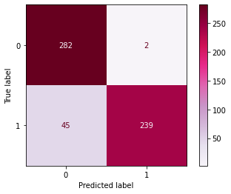
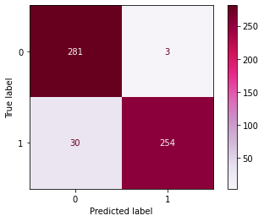
Scores
 | Random Forest | Naive Bayes
AUC Train Score | 0.9822 | 0.9956
AUC Test Score | 0.9811 | 0.9896
Accuracy Train Score | 0.9123 | 0.9539
Accuracy Test Score | 0.9172 | 0.9419
Confusion Matrix

Slide 14

Conclusion
01
All models can classify which subreddit a post has been given to
02
Best model recommendation is Naive Bayes
03
The difference between the test/training AUC score and accuracy score is not that huge
04
Naive Bayes AUC score and accuracy score is also the highest
05
The future step is to explore other models such as GradientBoost.
Notes:
### Conclusion
•All models can classify which subreddit a post has been given to.
- Best model recommendation: Naive Bayes
- The difference between the test/training AUC score and accuracy score is less than 0.01
- AUC score and accuracy score is also the highest
- Lower false negative and false positive
- Higher Recall(True Positive rate)
### Future Work:
* Explore other model such as GradientBoosting/Logistic Regression
* Remove top features that was given by RandomForest and re-run to explore if the classifier are able to classify which post belongs to which subreddit

Slide 15


